Slide 1
ACT and SAT ANALYSIS

Slide 2
BACKGROUND
ACT and SAT is a standardized test widely used in high school college for the admissions to U.S universities.
2.03 Million students took the ACT in 2017 ¹
1.8 Million students took the SAT in 2017 ²
Notes:
https://www.act.org/content/dam/act/unsecured/documents/cccr2017/CCCR_National_2017.pdf (ACT participation figures)
2. https://reports.collegeboard.org/archive/sat-suite-program-results/2017/overview#:~:text=The%20class%20of%202017%20is,takers%20took%20the%20new%20SAT (SAT participation figures)

Slide 3
Problem statement
Role: Analyst in the United States Department of Education
Problem statement: Do states that have a higher exam participation rate perform better than states with lower participation rates?
Rationale: If higher exam participation results in higher scores, it would provide strong grounds for states to mandate that all students participate in the ACT/SAT

Slide 4
Dataset
51 states in the USA
2017 and 2018 ACT/SAT participation rates and scores
States broken down by ethnicity ⁴
Notes:
4. https://worldpopulationreview.com/states/states-by-race (Breakdown by Ethnicity)

Slide 5
Data CLEANING
SAT
Replaced '52' to '524' typo for SAT 2017
Capitalized C in Columbia for SAT 2018
ACT
Dropped national from ACT 2017
Changed the 20.2x to 20.2 for ACT composite 2017
Changed typo of 2.3 to 23.2 for science ACT 2017
Dropped duplicate ‘Maine’ in 2018 act
Both
Removed % sign and changed to float for all datasets
Changed all column names to lower case

Slide 6
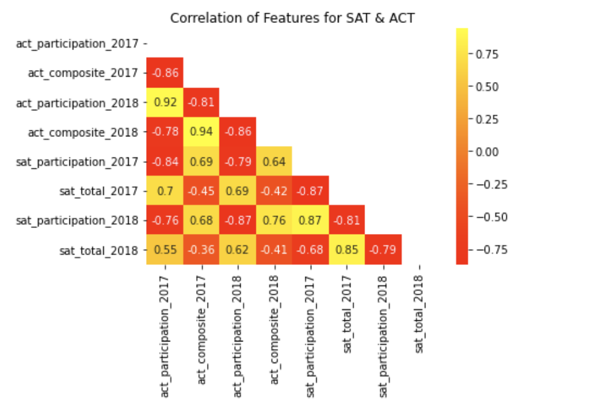
Exploratory data analysis
Feature 1 | Feature 2 | Correlation
ACT/SAT Scores | ACT/SAT Participation | -
ACT Participation | SAT Participation | -
ACT Score | SAT Score | -
2017 Participation | 2018 Participation | +
ACT/SAT Score 2017 | ACT/SAT Score 2018 | +

Slide 7
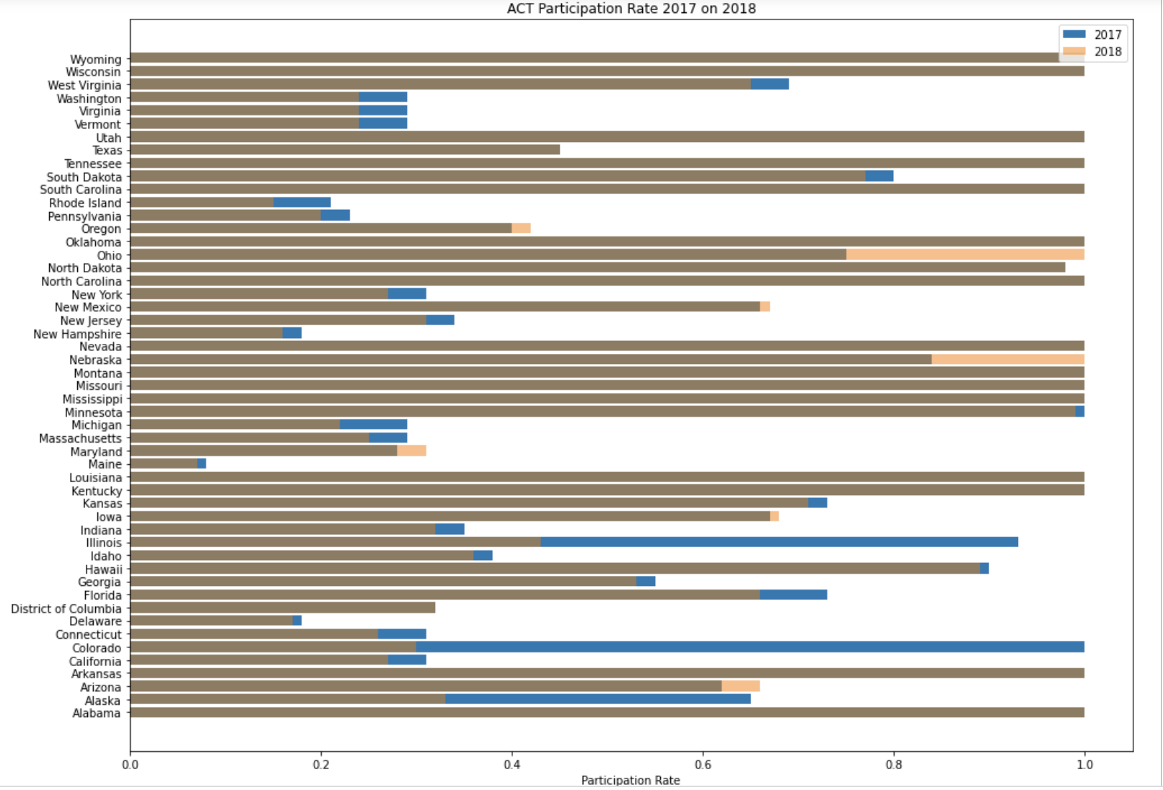
Bar chart for ACT Participation 2017 vs 2018

Slide 8
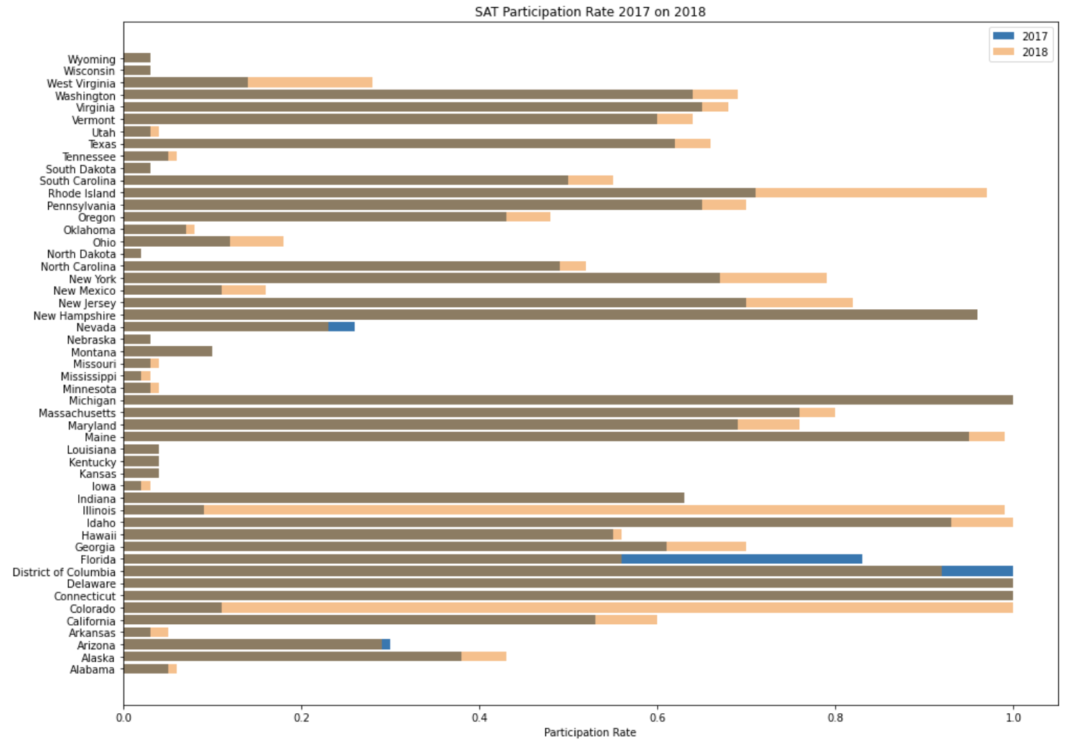
Bar chart for SAT Participation 2017 vs 2018

Slide 9
ANALYSIS FOR SIGNIFICANT changes in ACT/SAT PARTICIPATION
STATE | ACT |  | SAT |  | Possible Explanation
 | 2017 | 2018 | 2017 | 2018
Colorado | 100% | 30% | 11% | 100% | State policy switch from ACT to SAT ^{6,7}
Illinois | 93% | 43% | 9% | 99%
Alaska | 65% | 33% | 38% | 43% | State policy expiry for mandatory college aptitude tests for high school diploma ⁸
Notes:
6. https://www.coloradoindependent.com/2017/07/06/from-csap-to-parcc-heres-how-colorados-standardized-tests-have-changed-and-whats-next/ (Colorado switch to SAT)
7. https://www.chicagotribune.com/news/ct-illinois-chooses-sat-met-20160211-story.html (Illinois switch to SAT)
8. https://www.alaskapublic.org/2016/07/01/alaska-changes-hs-diploma-requirements-no-more-sat-act/ (Alaska drop ACT/SAT for diploma)

Slide 10
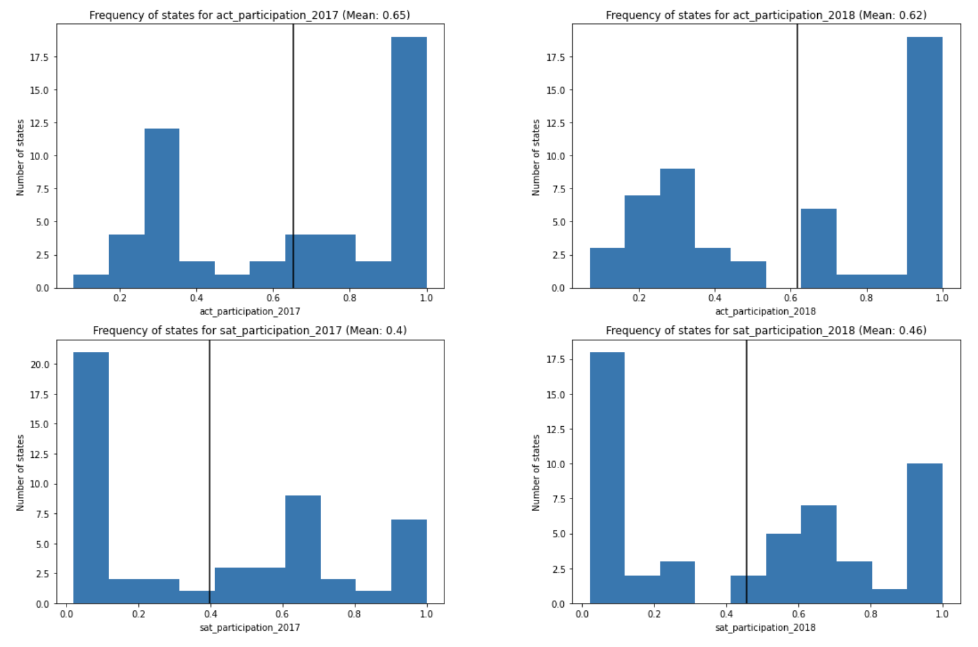
HistoGram for state participation
Analysis
We suspect that the participation rates follow a bimodal distribution (clustered around 2 peaks).
We can better verify this with a distplot with its KDE

Slide 11
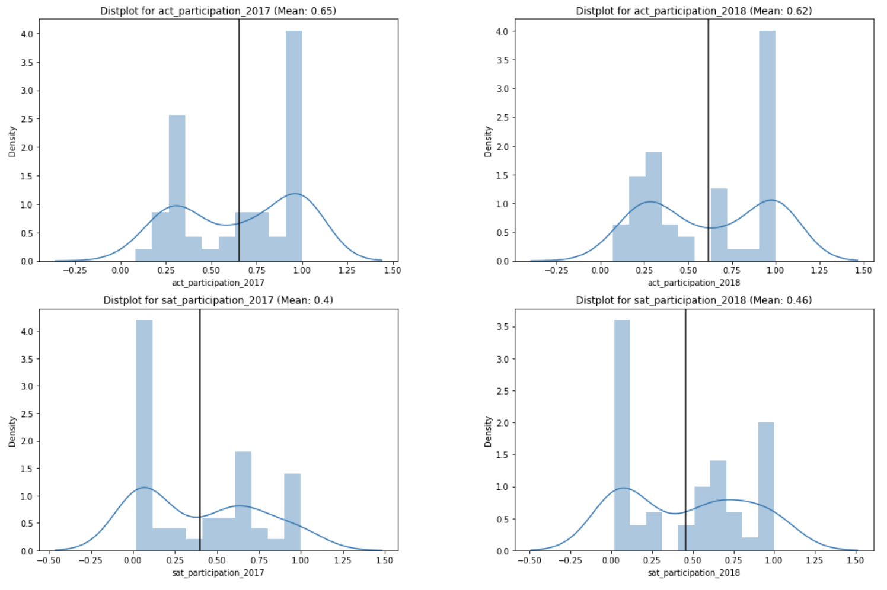
DISTPLOT FOR PARTICIPATION
Analysis
Bimodal distribution
ACT has higher mean participation rate than SAT

Slide 12
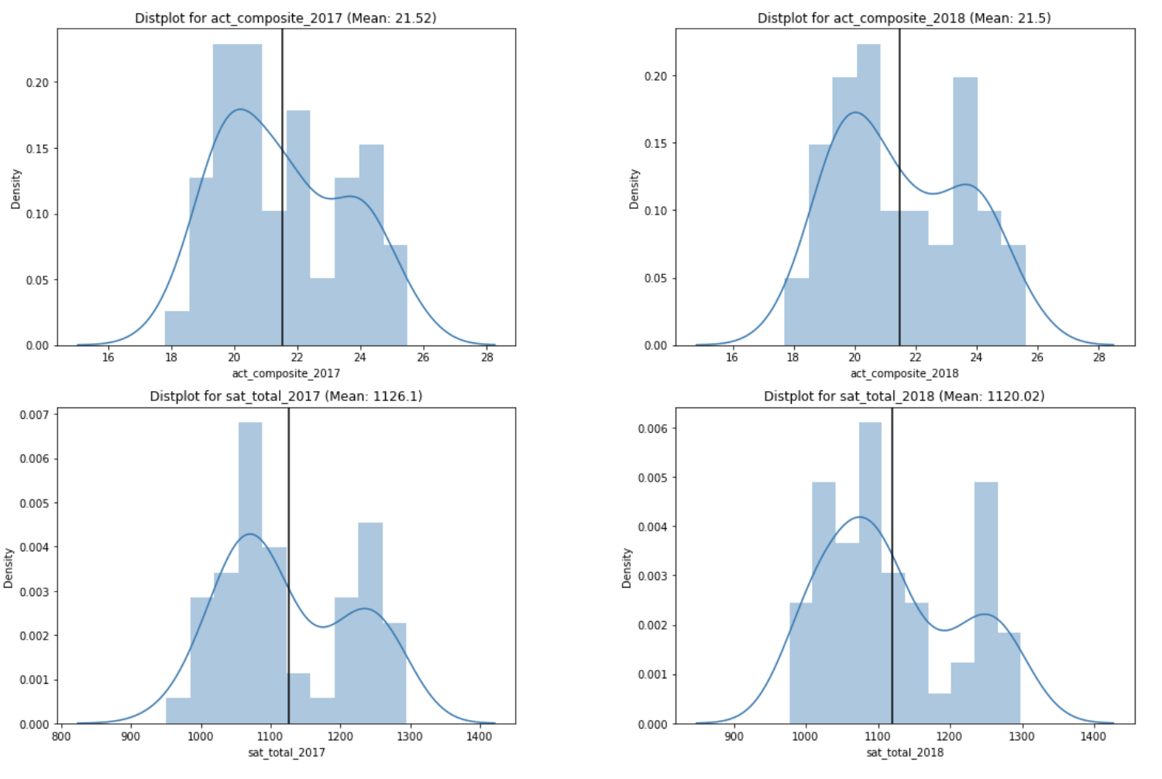
DISTPLOT FOR EXAM SCORES
Analysis
Bimodal distribution
Slightly positive skewed

Slide 13
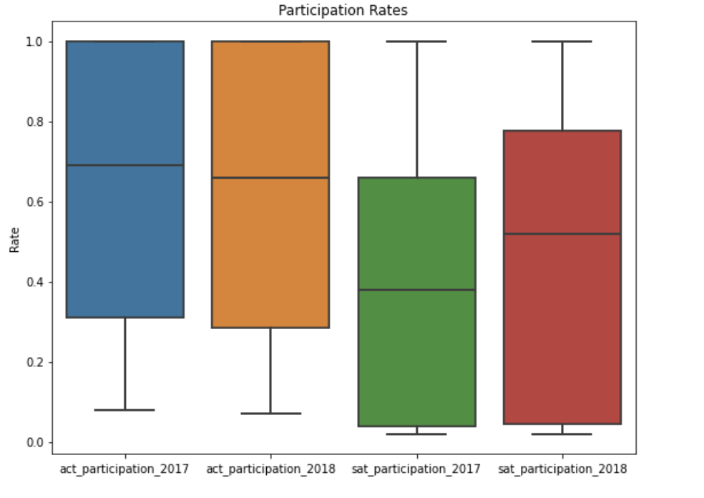
BoxPLOT FOR PARTICIPATION
Analysis
More test takers switching to SAT
States like Colorado and Illinois mandating switch ^{6,7}
Notes:
6. https://www.coloradoindependent.com/2017/07/06/from-csap-to-parcc-heres-how-colorados-standardized-tests-have-changed-and-whats-next/ (Colorado switch to SAT)
7. https://www.chicagotribune.com/news/ct-illinois-chooses-sat-met-20160211-story.html (Illinois switch to SAT)

Slide 14
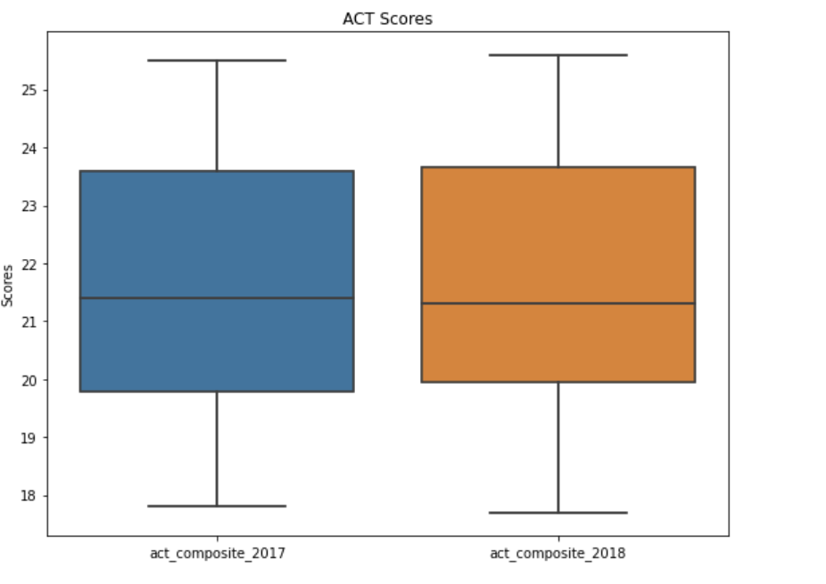
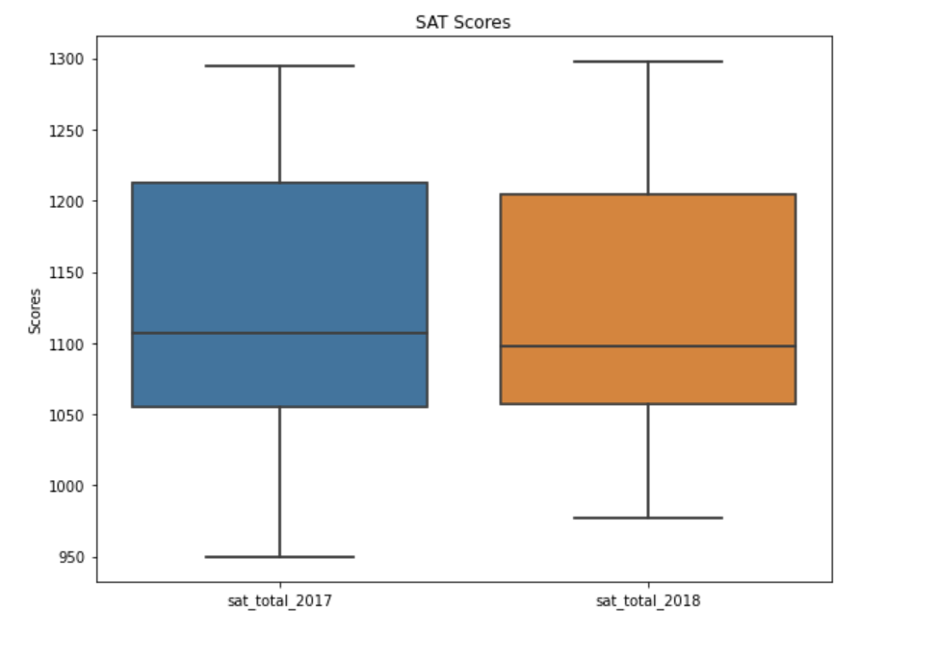
BoxPLOT FOR SCORES
Analysis
Decrease in median scores from 2017 to 2018
Tests could be harder or students weaker

Slide 15
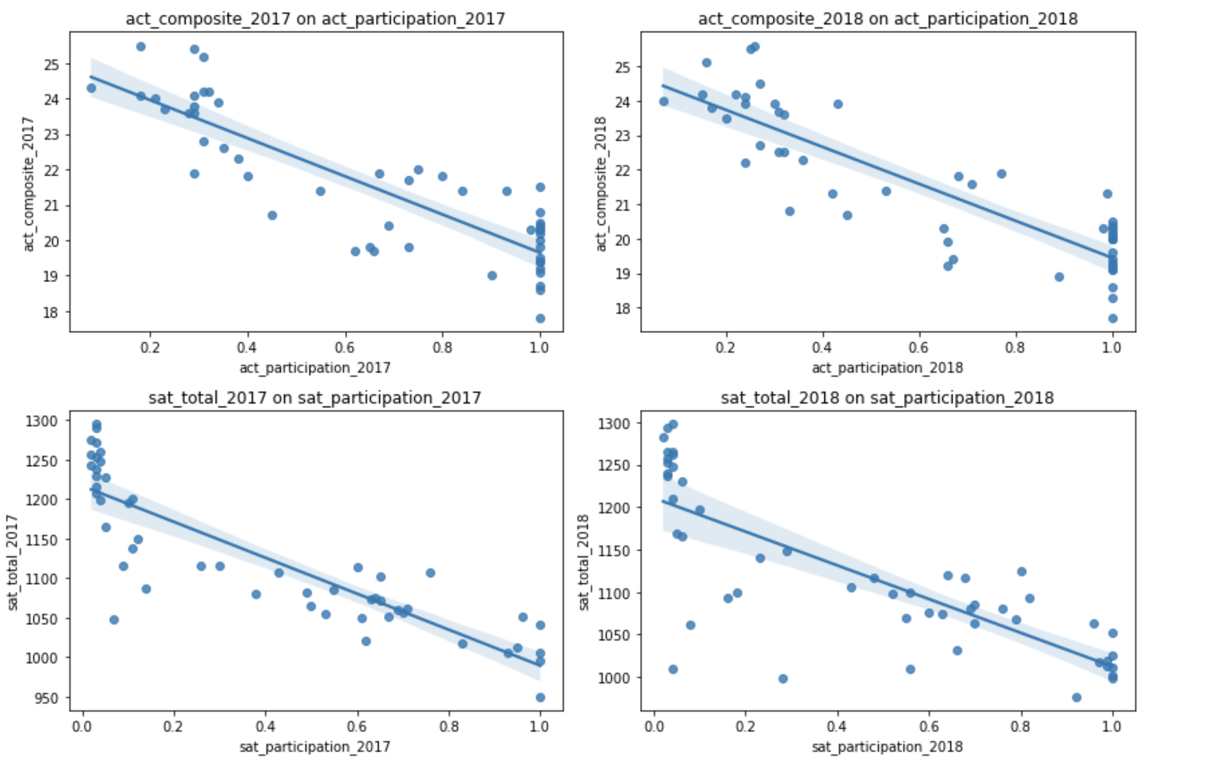
REGPLOT FOR SCORE ON PARTICIPATION
Analysis
Downward sloping curve indicates negative correlation between scores and participation

Slide 16
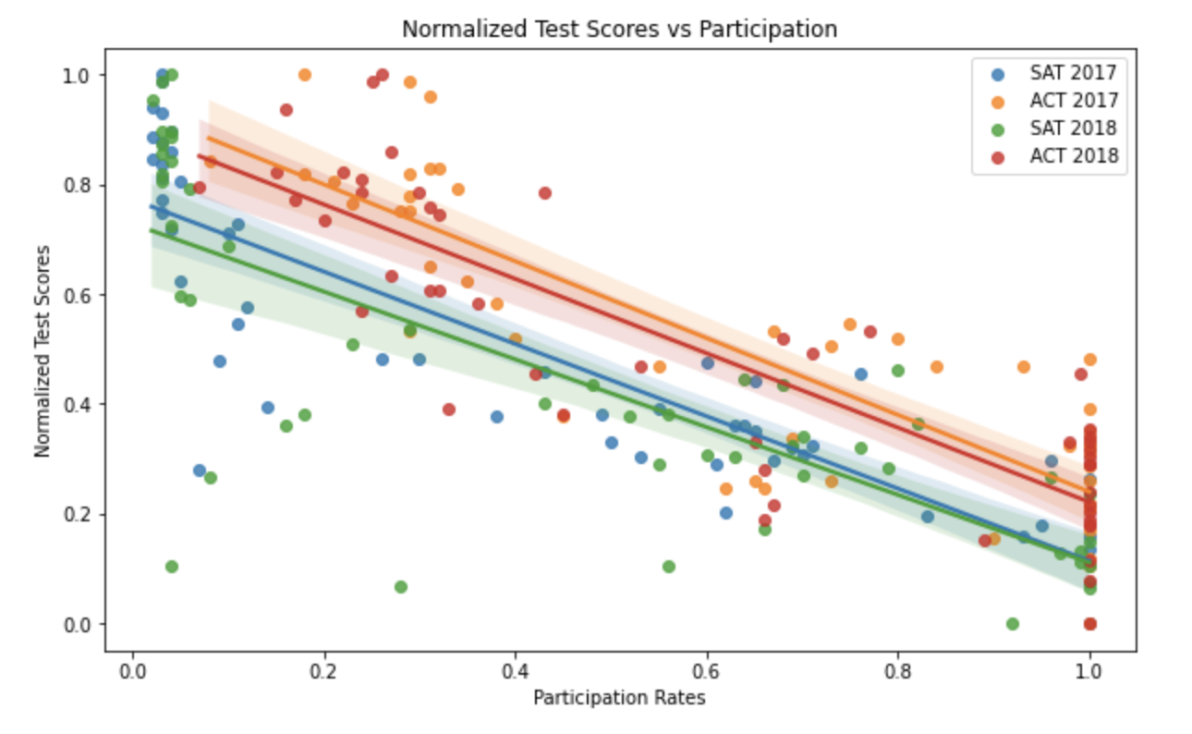
Normalized REGPLOT SCORE ON PARTICPATION

Slide 17
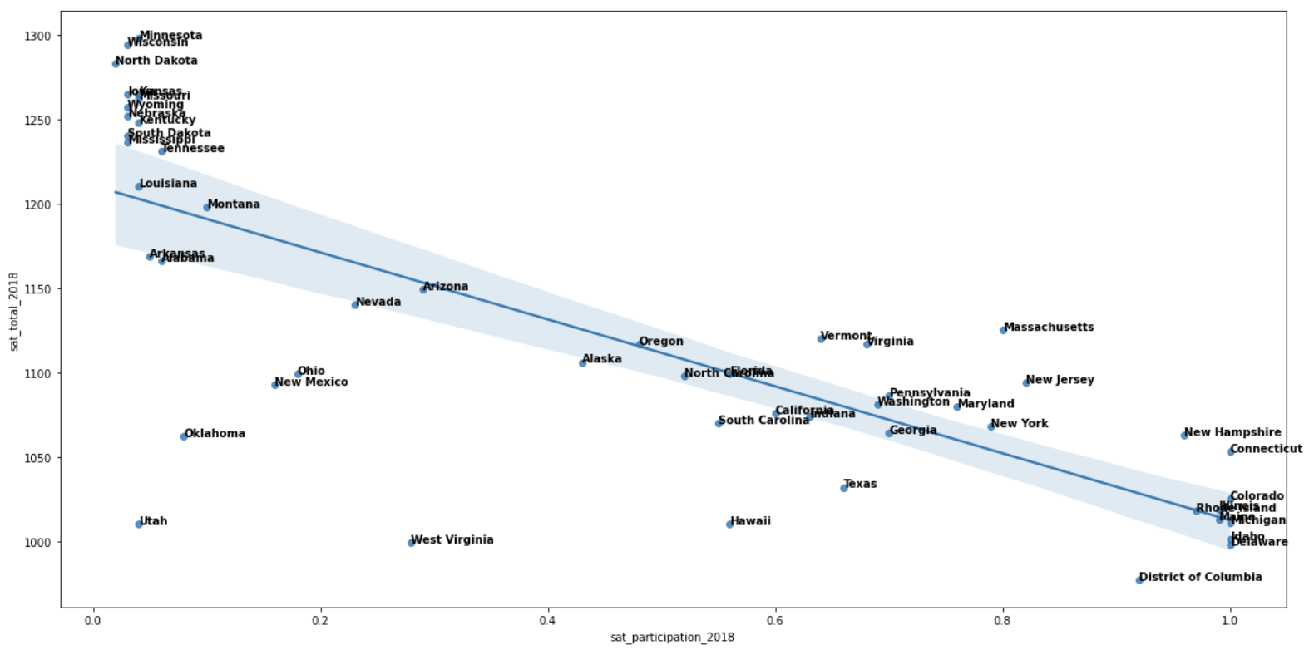
SCATTER PLOT SAT SCORE ON PARTICIPATION 2018

Slide 18
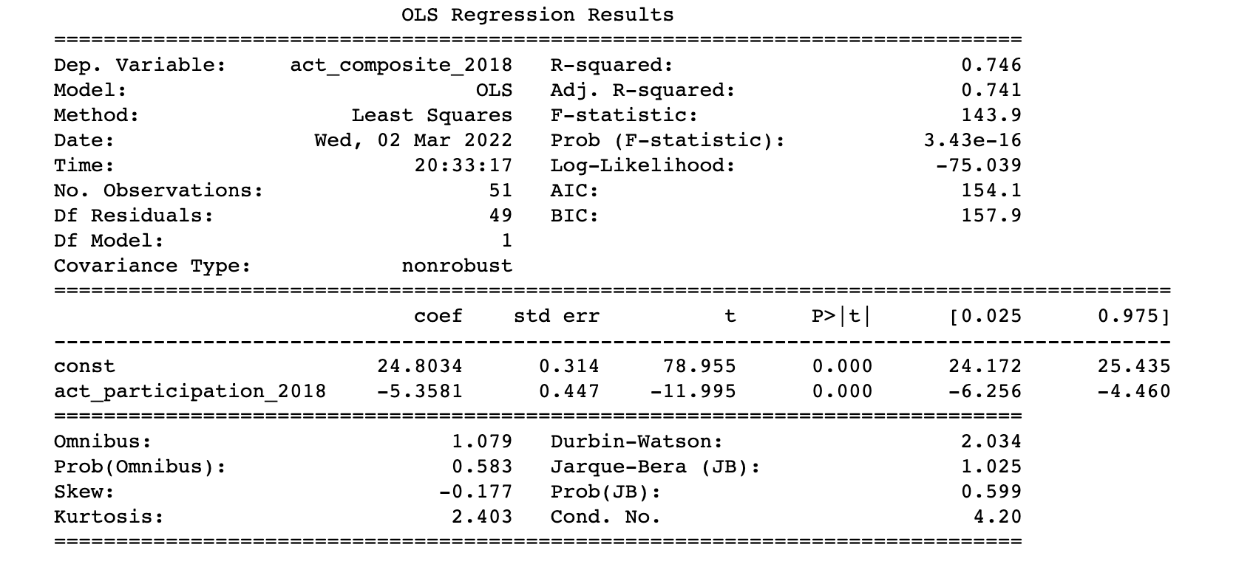
LINEAR REGRESSION: SCORE ON PARTICIPATION
Analysis
P-value less than 1%
Reject null hypothesis and accept negative correlation

Slide 19
TOP UNDERPERFORMING STATES
SAT
ACT
Oklahoma
West Virginia
Illinois
Utah
Hawaii
Alaska
Arizona
Nevada
New Mexico
Texas

Slide 20
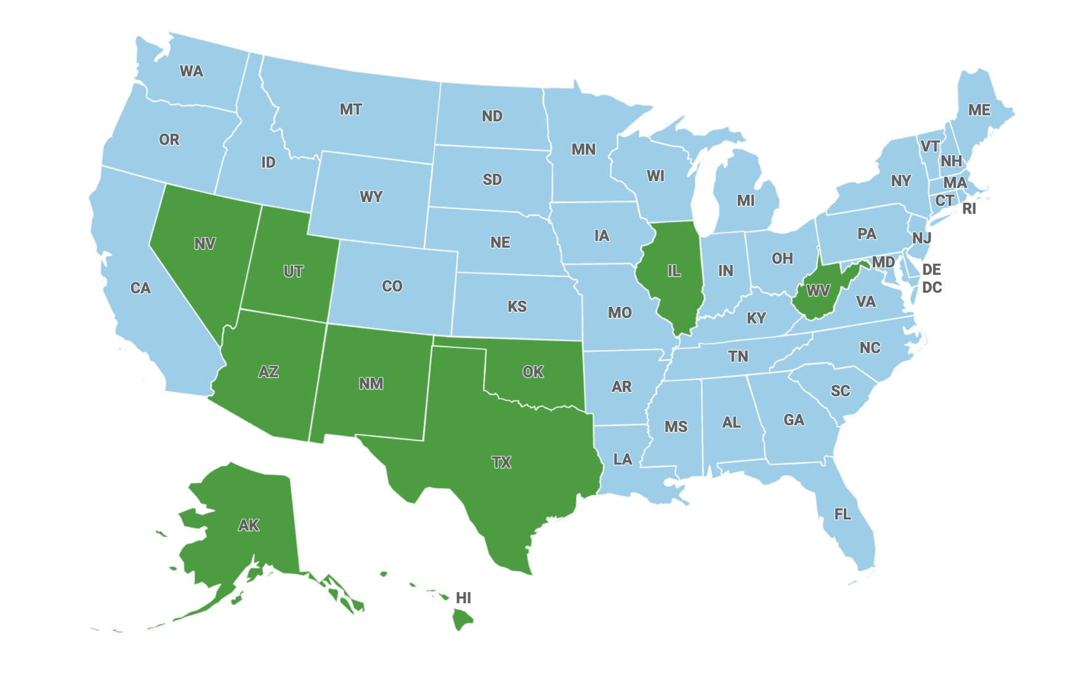
Map of underperforming states
Analysis
Many underperforming states lie in the south west near Mexico
Does ethnicity play a part in lower exam scores?

Slide 21
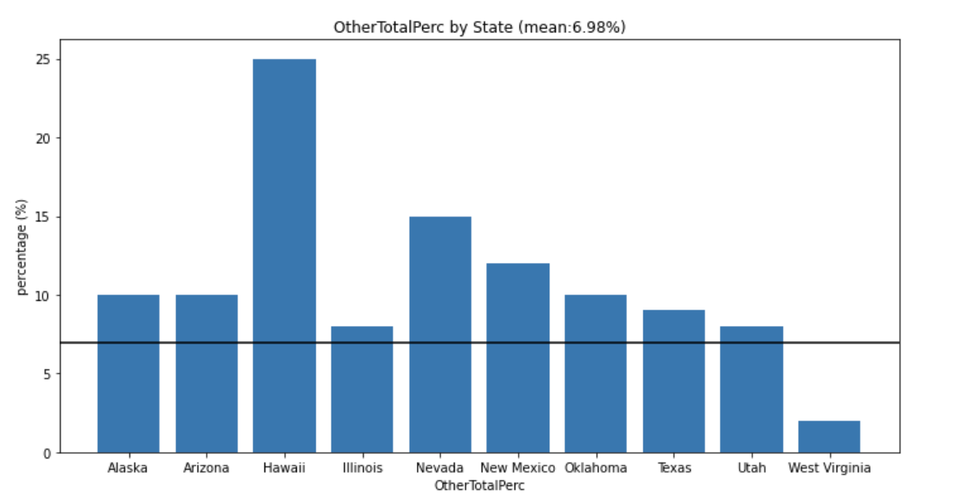
BAR CHART OF ‘Others’ ETHNICITY BY STATE
Analysis
9 out of 10 of top underperforming states have higher ‘Others’ ethnicity than the national average

Slide 22
Conclusion and recommendations
Problem statement: Do states that have a higher exam participation rate perform better than states with lower participation rates?
Higher participation rates results in lower ACT/SAT exam scores
Could be caused by selection bias where only the best students take the exam
Other Recommendations
The Department of Education should ensure that all students have equal access to education resources regardless of ethnicity ⁹
Texas and New Mexico could be prioritized as they have the most room for improvement
Notes:
9. https://blog.prepscholar.com/average-sat-and-act-scores-by-stated-adjusted-for-participation-rate (Selection Bias of participation rates)

Slide 23
Sources
1. https://www.act.org/content/dam/act/unsecured/documents/cccr2017/CCCR_National_2017.pdf (ACT participation figures)
2. https://reports.collegeboard.org/archive/sat-suite-program-results/2017/overview#:~:text=The%20class%20of%202017%20is,takers%20took%20the%20new%20SAT (SAT participation figures)
3. https://www.statista.com/statistics/259865/percentage-of-hispanic-population-in-the-us-by-state/ (Hispanic Breakdown)
4. https://worldpopulationreview.com/states/states-by-race (Breakdown by Ethnicity)
5. https://cdn.americanprogress.org/content/uploads/2018/11/08042733/LessonsLearned_SchoolFunding-report-4.pdf (Less funding)
6. https://www.coloradoindependent.com/2017/07/06/from-csap-to-parcc-heres-how-colorados-standardized-tests-have-changed-and-whats-next/ (Colorado switch to SAT)
7. https://www.chicagotribune.com/news/ct-illinois-chooses-sat-met-20160211-story.html (Illinois switch to SAT)
8. https://www.alaskapublic.org/2016/07/01/alaska-changes-hs-diploma-requirements-no-more-sat-act/ (Alaska drop ACT/SAT for diploma)
9. https://blog.prepscholar.com/average-sat-and-act-scores-by-stated-adjusted-for-participation-rate (Selection Bias of participation rates)

